Slide 1

World Airplane Safety Review
Amy Nestingen

Slide 2
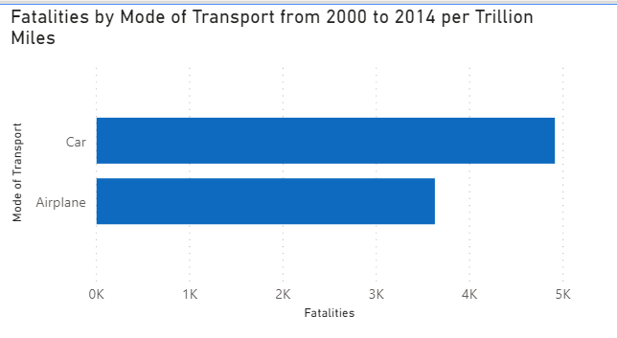
Fatalities by Mode of Transport

Slide 3
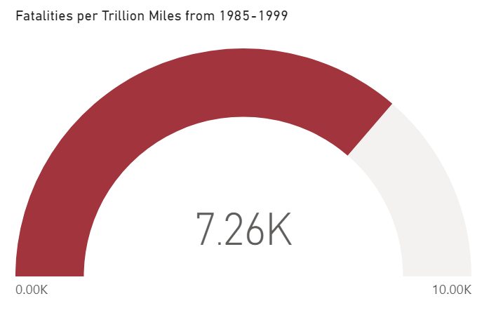
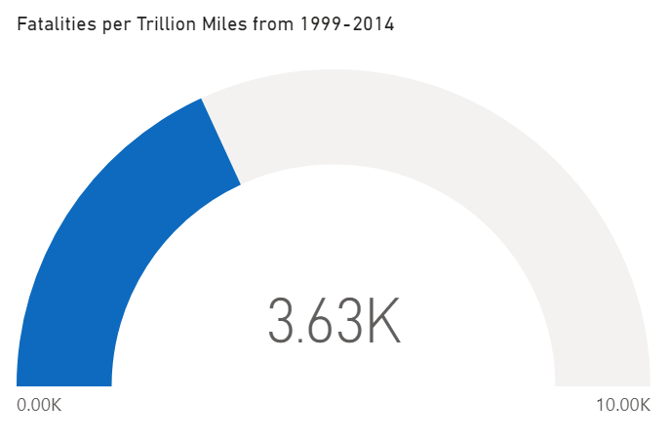
Airline Safety has Improved in last 15 years

Slide 4
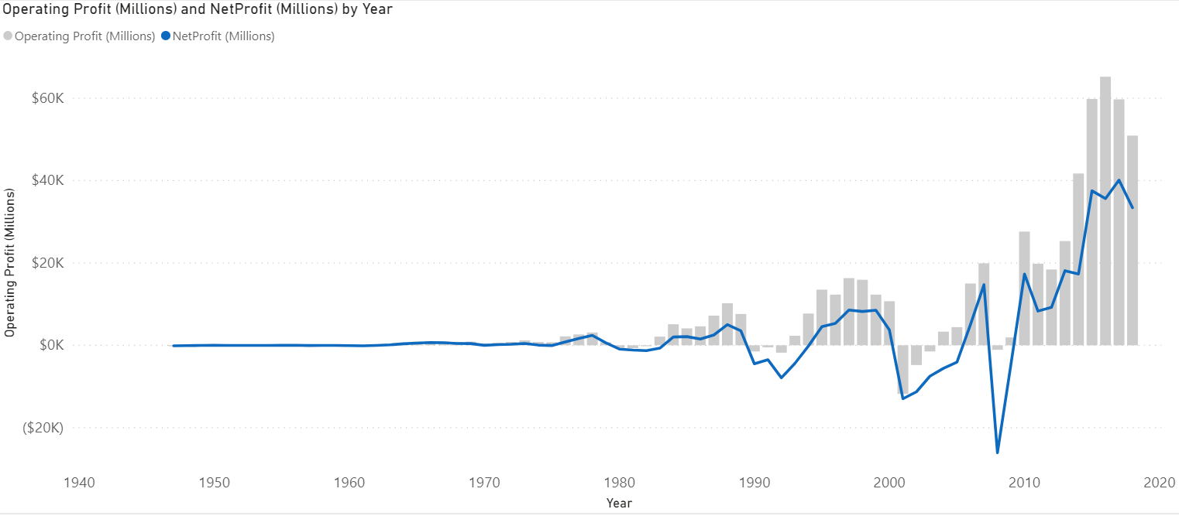
Annual Profits Results: World Airlines

Slide 5
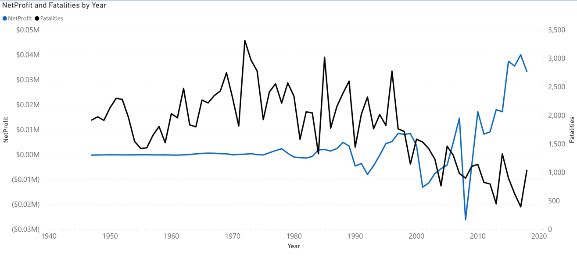
Fatalities Relationship with Net Profits Many Factors but Safety is one of them

Slide 6
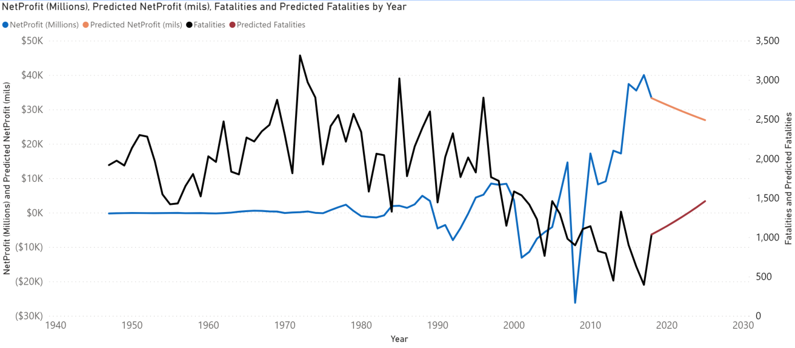
If Fatalities increase by 5% YOY Net Profits have a risk of decreasing by 3% YOY

Slide 7
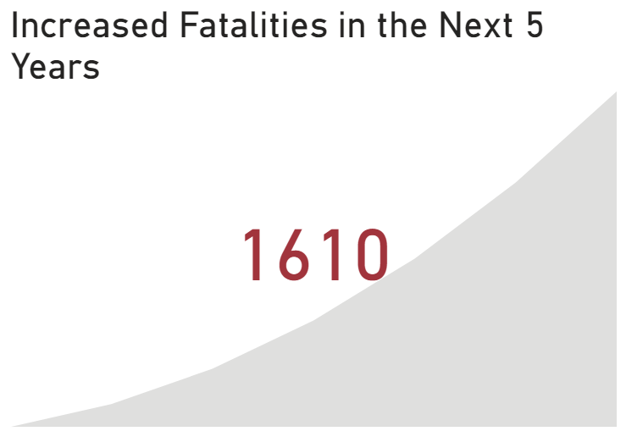
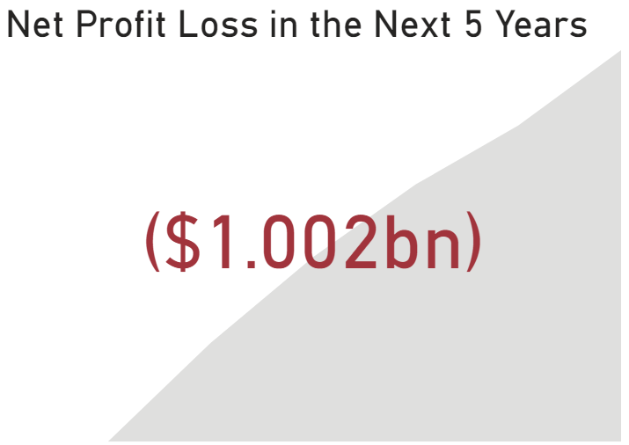
The Ugly Truth: If Fatalities increase by 3% YOY which causes a 5% YOY Net Profit Loss
Cumulative Fatalities
Cumulative Net Profit Loss

Slide 8
Action Plan
Safety Needs to be the focus of the Airline Industry. We must do everything in our power to create safe travel.
We need to remind our customers of our safety values and show them the facts that airplane travel is safer than car travel
We show our customers that airplane travel has become safer over the last 15 years and state what we are doing to continue that safety trend.

Slide 9
Sources
https://www.airlines.org/dataset/annual-results-world-airlines/#
http://www.baaa-acro.com/statistics
https://github.com/fivethirtyeight/data/tree/master/airline-safety
https://policyadvice.net/car-insurance/insights/how-much-do-americans-drive/
https://www-statista-com.ezproxy.bellevue.edu/statistics/241488/population-of-the-us-by-sex-and-age/
Github Link: https://github.com/nestingen/DSC-640-Project

